Slide 1
CS4038
DATA MINING
LECTURE # 05
SPRING 2024
FAST – NUCES, CFD CAMPUS
AYESHA LIAQAT
ayesha.liaqat@nu.edu.pk

Slide 2
TODAY’S TOPICS
Data Preprocessing
Data cleaning
Handling missing values
Handling noise
Data integration
Handling data redundancy
2

Slide 3
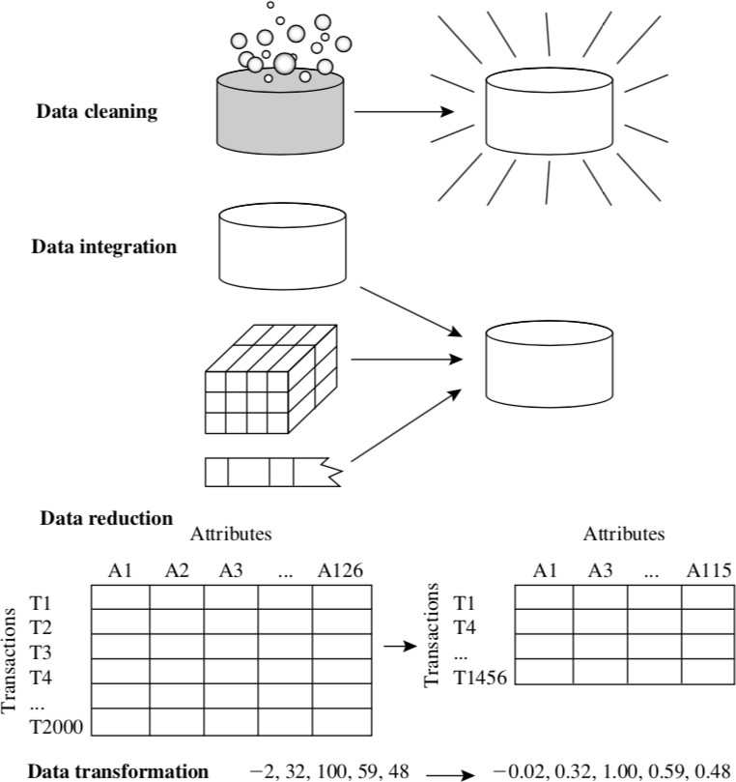
FORMS OF DATA PREPROCESSING
3

Slide 4
MAJOR TASKS IN DATA PREPROCESSING
Data cleaning
Fill in missing values, smooth noisy data, identify or remove outliers, and resolve
inconsistencies
Data integration
Integration of multiple databases, data cubes, or files
Data transformation
Normalization and aggregation
Data reduction
Obtains reduced representation in volume but produces the same or similar analytical
results
Data discretization
Part of data reduction but with particular importance, especially for numerical data
Notes:
Data integ: customer_id and cust_id in diff dbs. Same Firstname as Bill, William, B. . Redundancy during integration.
Data reduction: dimensionality and numerosity reduction

Slide 5
DATA PREPROCESSING
DATA CLEANING

Slide 6
DATA CLEANING
Importance:
“Data cleaning is one of the three biggest problems in data warehousing”— Ralph Kimball
“Data cleaning is the number one problem in data warehousing”—DCI survey
Data cleaning tasks
Fill in missing values
Identify outliers and smooth out noisy data
Correct inconsistent data
Resolve redundancy caused by data integration

Slide 7
MISSING DATA
Data is not always available
E.g., many tuples have no recorded value for several attributes, such as customer income in sales data
Missing data may be due to
equipment malfunction
inconsistent with other recorded data and thus deleted
data not entered due to misunderstanding
certain data may not be considered important at the time of entry
not register history or changes of the data
Missing data may need to be inferred.

Slide 8
HOW TO HANDLE MISSING DATA?
Ignore the tuple, usually done when class label is missing (assuming the tasks in classification—not effective when the percentage of missing values per attribute varies considerably.
Fill in the missing value manually: tedious + infeasible? Not good for large dataset
Fill in it automatically with
a global constant : e.g.,“unknown”, a new class?!
the attribute mean (or median for skewed data)
the attribute mean for all samples belonging to the same class: smarter
the most probable value: inference-based such as Bayesian formula or decision tree
Considered as the most reliable approach

Slide 9
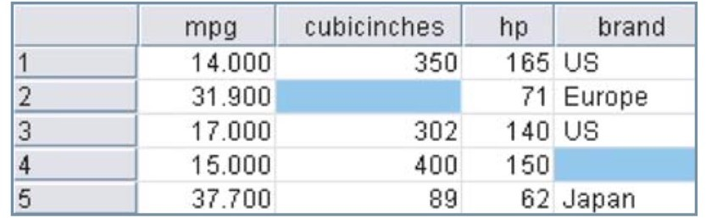
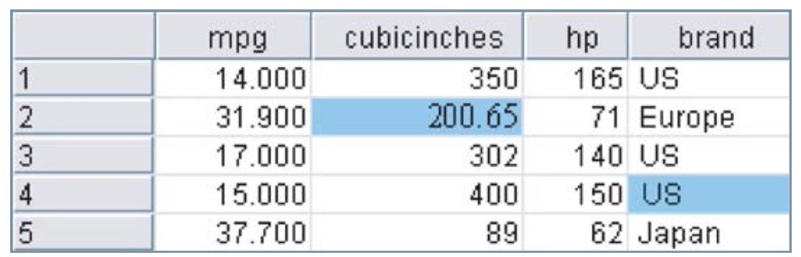
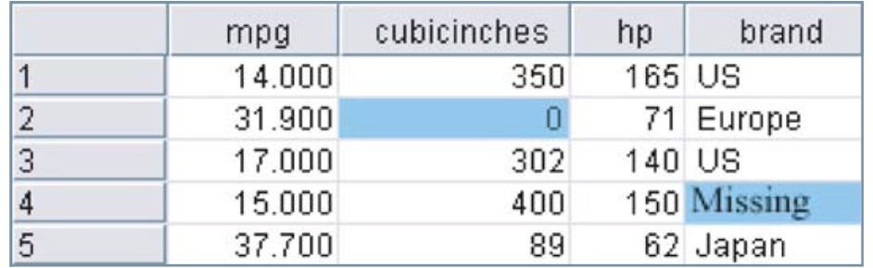
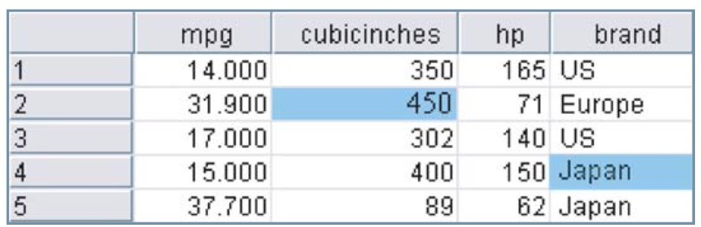
REPLACE MISSING DATA: EXAMPLES
a. Data with missing values
c. Replaced with mean and mode
b. Replaced with user-defined constants d. Replaced with random values
The selection of an appropriate method depends on the context.

Slide 10
HOW TO HANDLE MISSING DATA?
Estimating missing values based on other values is known as ‘data imputation’.
In data imputation, we ask “What would be the most likely value for this missing value, given all the other attributes for a particular record?”
That is, data imputation methods take advantage of the knowledge that the car is Japanese while calculating its missing cubic inches.
Methods include multiple regression or classification and regression trees.

Slide 11
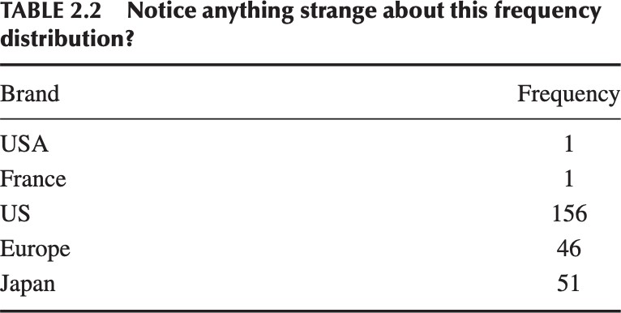
DATA CLEANING
Other data problems which requires data cleaning
duplicate records
incomplete data
inconsistent data

Slide 12
NOISY DATA
Noise: random error or variance in a measured variable
Incorrect attribute values may occur due to
faulty data collection instruments
data entry problems
data transmission problems
technology limitation
inconsistency in naming convention

Slide 13
HOW TO HANDLE NOISY DATA?
Binning method:
first sort data and partition into bins
then one can smooth by bin means, smooth by bin median, smooth by bin boundaries, etc.
Combined computer and human inspection
detect suspicious values and check by human (e.g., deal with possible outliers)
Clustering
detect and remove outliers
Regression
smooth by fitting the data into regression functions
Notes:
Binning method consult neighborhood values so “local smoothing”. Discretization Technique and reduction(less distinct values in an attr) techniques

Slide 14
BINNING
Works on sorted data to smooth the noise.
Equal-width (distance) partitioning:
Divides the range into N intervals of equal size: uniform grid
if A and B are the lowest and highest values of the attribute, the width of intervals will be:
W = (B – A)/K
K: number of bins required
And the interval boundaries are:
A+W, A+2W, A+3W, …, A+(K-1)W
Notes:
4,7,3,8,3,6,12,18,15
A=Min= 3 B=Max: 18 k=3 w=(18-3)/3=5
3+5=8 3+2(5)=13 3+3(5)=18

Slide 15
BINNING: EQUAL WIDTH EXAMPLE
Equal-width (distance) partitioning
Sorted data (e.g., by price)
4, 8, 9, 15, 21, 21, 24, 25, 26, 28, 29, 34
Min = 4, Max = 34, let’s say we want 3 bins (i.e., K=3)
W = (Max – Min) / K = 10
Our 3 interval boundaries will become:
Bin 1 (Min + W = 14): it will contain all values until 14
Bin1: 4, 8, 9
Bin 2 (Min + 2W = 24): it will contain all values until 24
Bin2: 15, 21, 21, 24
Bin 3 (Min + 3W = 34): it will contain all values until 34
Bin3: 25, 26, 28, 29, 34
The most straightforward, but outliers may dominate presentation
Skewed data is not handled well.
Notes:
Good for symmetric data

Slide 16
BINNING
Equal-frequency (depth) partitioning:
Divides the range into N intervals, each containing approximately same number of samples
Good data scaling
Managing categorical attributes can be tricky.
To determine best number of intervals (K) for both methods, look at the histogram chart of the input data and try different values.

Slide 17
BINNING: EQUAL FREQUENCY EXAMPLE
Sorted data (e.g., by price)
4, 8, 9, 15, 21, 21, 24, 25, 26, 28, 29, 34
Partition into (equi-depth/frequency) bins:
Let, K = 3, N = 12, frequency of each bin = N/K = 12/3 = 4
Bin 1:
Bin 2:
Bin 3:
4, 8, 9, 15
21, 21, 24, 25
26, 28, 29, 34
Notes:
Good for skewed data and outliers

Slide 18
BINNING METHODS FOR DATA SMOOTHING
Sorted data (e.g., by price)
4, 8, 9, 15, 21, 21, 24, 25, 26, 28, 29, 34
Partition into (equi-depth/frequency) bins:
Bin 1:
Bin 2:
Bin 3:
4, 8, 9, 15
21, 21, 24, 25
26, 28, 29, 34
Smoothing by bin means:
Bin 1:
Bin 2:
Bin 3:
9, 9, 9, 9
23, 23, 23, 23
29, 29, 29, 29
Smoothing by bin boundaries:
Bin 1:
Bin 2:
Bin 3:
4, 4, 4, 15
21, 21, 25, 25
26, 26, 26, 34

Slide 19
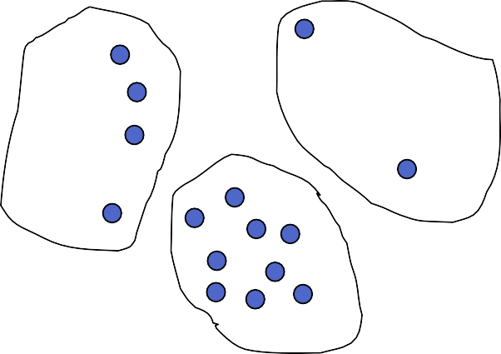
CLUSTER ANALYSIS

Slide 20
REGRESSION
y
Y1
Y1’
y = x + 1
X1
x

Slide 21
DATA PREPROCESSING
DATA INTEGRATION

Slide 22
DATA INTEGRATION
Data integration:
combines data from multiple sources into a coherent store
Schema integration
integrate metadata from different sources
Entity identification problem: identify real world entities from multiple data sources, e.g., A.cust-id ≡ B.cust-num
Detecting and resolving data value conflicts
for the same real-world entity, attribute values from different sources are different
possible reasons: different representations e.g., date formats; or different scales, e.g., metric vs. British units
Notes:
Metadata= name, meaning, datatype, range of values permitted, null rules helps to avoid error during integration
e.g.... Codes for pay-type are S and H at one place and 1 and 2 at another place

Slide 23
HANDLING REDUNDANCY IN DATA INTEGRATION
Redundant data occur often when integration of multiple databases
The same attribute may have different names in different databases.
One attribute may be a “derived” attribute in another table, e.g., annual revenue and sales, age and birth year
Careful integration of the data from multiple sources may help reduce/avoid redundancies and inconsistencies and improve mining speed and quality
Redundant data may be able to be detected by correlational analysis

Slide 24
DETECTING REDUNDANT DATA
Followings are the correlational analysis methods.
X² test (for nominal, categorical or discrete data)
Correlation coefficient and covariance (for numeric or quantitative data)
Notes:
To identify r/p b/w 2 attributes

Slide 25
DETECTING REDUNDANT DATA
Followings are the correlational analysis methods.
1.
X² test
(for nominal, categorical or discrete data)
Basic idea: The X² checks the hypothesis that two attributes, A and B, are independent. If this hypothesis can be rejected, we can say that A and B are statistically correlated and one of them (either A or B) can be discarded.
2. Correlation coefficient and covariance analysis (for numeric or quantitative data)

Slide 26
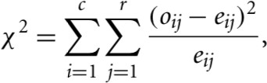

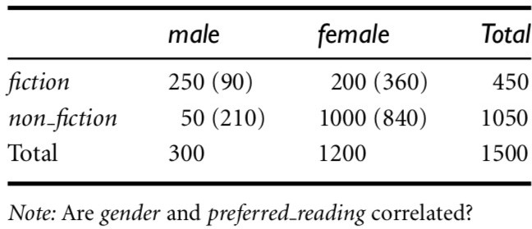
CHI-SQUARE CORRELATION TEST FOR NOMINAL DATA
For two nominal attributes, A and B, correlation can be determined using X² (chi- square) test.
A contingency table is constructed with values of A and B such that (A_{i}, B_{j}) denote the joint event that attribute A takes on value a_{i} and attribute B takes on value b_{j}.
The X² value is computed as:
o_{ij} is the observed frequency (or actual count) of the joint event (A_{i}, B_{j}) and e_{ij} is the expected frequency of (A_{i}, B_{j})

Slide 27
CHI-SQUARE CORRELATION TEST FOR NOMINAL DATA
To perform X² test:
Formulate hypothesis
Create contingency table of (collected) data
Calculate X² value
Test the hypothesis; null hypothesis rejected or not.

Slide 28
EXAMPLE: CHI-SQUARE CORRELATION TEST
Step 1: Formulate hypotheses
For Hypothesis testing, first we need to formulate our null (H₀) and alternative (H_{a}) hypotheses:
H₀: Gender and reading preference variables are independent
H_{a}: Gender and reading preference variables are dependent
Null hypothesis is assumed to be true until we have evidence to reject it.
Chi-square correlation test is also known as Chi-square test of independence.

Slide 29
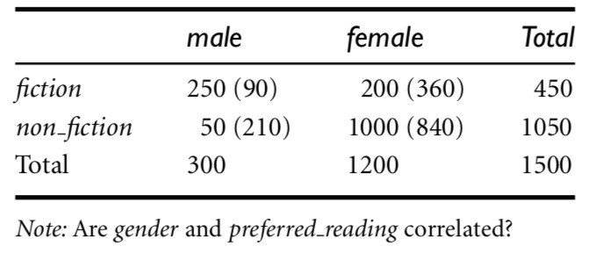
EXAMPLE: CHI-SQUARE CORRELATION TEST
Step 2: Create contingency table
Example 3.1 (from book by Han)
1500 people surveyed about their preferred type of reading material.
Gender is also recorded with their responses.
The chi-square test will determine if the difference in reading preferences based on gender is occurring by chance or the difference is statistically significant.
Notes:
Total=n=1500 gender, preferred reading

Slide 30

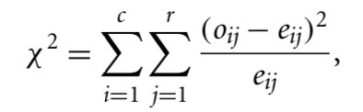
EXAMPLE: CHI-SQUARE CORRELATION TEST
Step 3: Calculate Chi-square test statistic
Example 3.1 (from book by Han)
1500 people surveyed about their preferred type of reading material.
Gender is also recorded with their responses.
Compute the chi-square value using X²
formula.
Compute the remaining expected values.

Slide 31
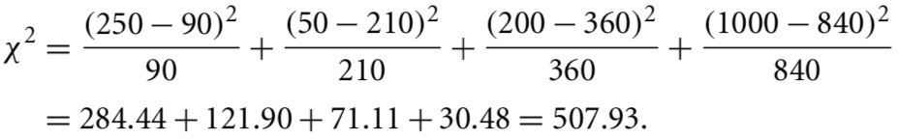
EXAMPLE: CHI-SQUARE CORRELATION TEST
Step 3: Calculate Chi-square test statistic
Example 3.1 (from book by Han)
1500 people surveyed about their preferred type of reading material.
Gender is also recorded with their responses.
Compute the chi-square value using X²
formula.
The chi-square test statistics is
507.93.
To be continued…
35

Slide 32
READING MATERIAL
Chapter 2:Tan, Steinbach & Kumar
Chapter 3: Han, Kamber & Pei
An article on Chi-Square Test: https://online.stat.psu.edu/stat500/lesson/8/8.1
40

